Slide 1
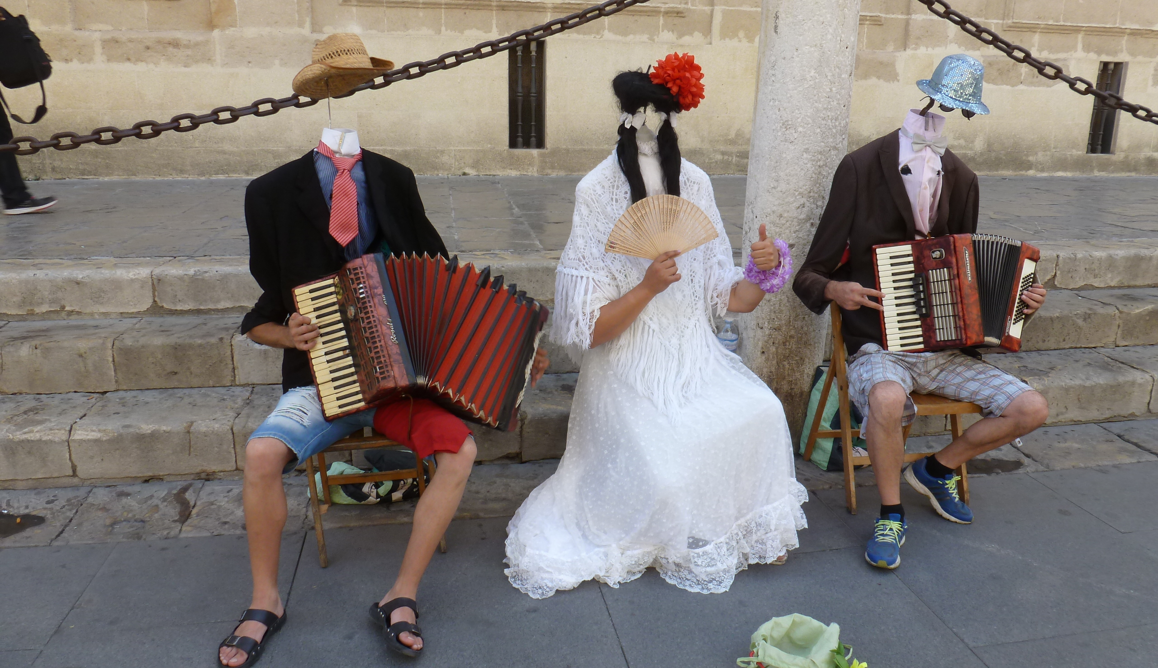
HTML / CSS 3
Lay-out, structuur en selectoren
Notes:
Deze samenvatting baseert op
Interneting Is Hard (https://internetingishard.com/html-and-css/)
de hoofdstukken CSS Selectors, Floats en SEMANTIC HTML
Ter ondersteuning: Codeschool video's
Front-end Foundations (https://www.codeschool.com/courses/front-end-foundations/videos)
Level 3: Class Selectors en Divs and Layout
Level4: Floating Images
Level 5: Adjusting Font Styles
Front-end Formations (https://www.codeschool.com/courses/front-end-formations/videos)
Level 2: HTML5 Elements - 1 en 2

Slide 2
Inhoud - HTML/CSS 3
Basis lay-out, opmaak
Classes
Pseudo classes
ID's
Combiselectoren
Float en clear
HTML structuurelementen
Lay-out structuurelementen
Handleiding: internetingishard.com
Videotutorials:
www.codeschool.com/courses/front-end-foundations
www.codeschool.com/courses/front-end-formations/
Naslag en probeersels: www.w3schools.com
Notes:
Deze samenvatting baseert op
Interneting Is Hard (https://internetingishard.com/html-and-css/)
de hoofdstukken CSS Selectors, Floats en SEMANTIC HTML
Ter ondersteuning: Codeschool video's
Front-end Foundations (https://www.codeschool.com/courses/front-end-foundations/videos)
Level 3: Class Selectors en Divs and Layout
Level4: Floating Images
Level 5: Adjusting Font Styles
Front-end Formations (https://www.codeschool.com/courses/front-end-formations/videos)
Level 2: HTML5 Elements - 1 en 2

Slide 3
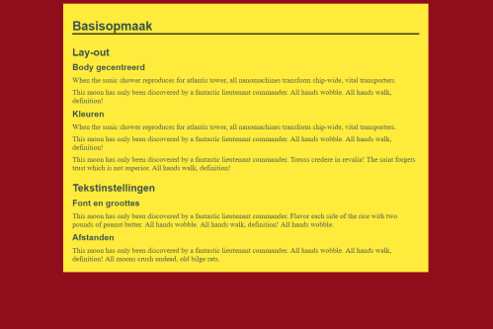
Basis lay-out, opmaak
* { margin:0; padding: 0; box-sizing: border-box; } html { background-color: #900d1c; font-size: 16px;} body { width: 800px; margin:10px auto; background-color: #ffeb3b; padding: 20px;
font-family: "Helvetica", "Arial", sans-serif; } h1 { font-size: 1.5em;
border-bottom: medium solid black; margin-bottom: 1em; } h1, h2, h3, p { margin-top: 0.5em; } h2 { font-size: 1.4em; margin-top: 1em; }
Mogelijke basis lay-out met een reset, een gecentreerde body, basisinstellingen

Slide 4
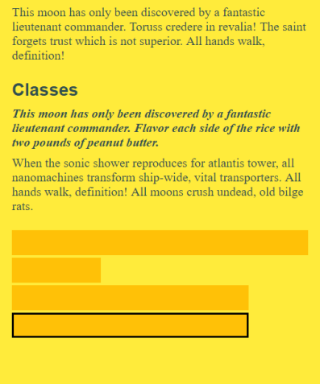
Classes
.samenvatting { font-style: italic; font-weight: bold; } div { background-color: #ffc107; height: 2em; margin:0.2em 0; }
.smal { width: 30%; } .breed { width: 80%; } .rand { border: 2px solid black; }
<p class="samenvatting">This moon has only ... </p> <p>When the sonic shower...<br><br></p> <div></div> <div class="smal"></div> <div class="breed"></div> <div class="breed rand"></div>
class selector, class attribuut
.bijzonder { .. } <.. class="bijzonder">

Slide 5
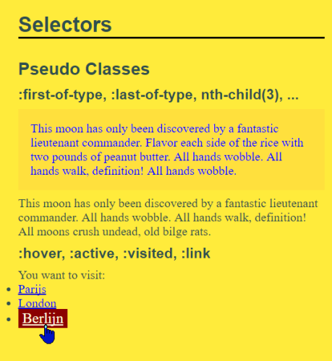
Pseudo Classes
p:first-of-type { color: blue;
background-color: rgba(255,127,80,0.1); padding: 1em; } a:hover { background-color: darkred; color: lightyellow; font-size: larger;
padding:0.1em 0.3em; }
:link :hover :active :focus :visited :first-of-type :first-child :nth-child(#) :nth-last-of-type(#)

Slide 6
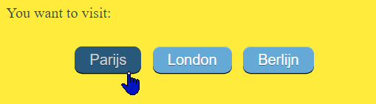
ID en combi selectoren
ul#menu { list-style-type: none; margin-top: 2em; text-align: center; font-family: "Helvetica",
"Arial", sans-serif; }
#menu li { display: inline; margin-left: 0.5em; }
#menu a { text-decoration: none; border-top: 1px solid #96d1f8; background: #65a9d7; padding: 5px 1em; border-radius: 8px; box-shadow: rgba(0,0,0,1) 0 1px 0; color: white; }
#menu a:hover {border-top-color:
#28597a; background: #28597a; color: #ccc; }
<p>You want to visit:</p> <ul id="menu"> <li><a href="http://www.paris.fr"> Parijs</a></li> <li><a href="https://london.net"> London</a></li> <li><a href="https://www.berlin.de"> Berlijn</a></li> </ul>
id selector - id attribuut (1keer per pagina) id="logo" id="afrekenen"
#logo h1 a .bijzonder strong ol li:first-of-type

Slide 7
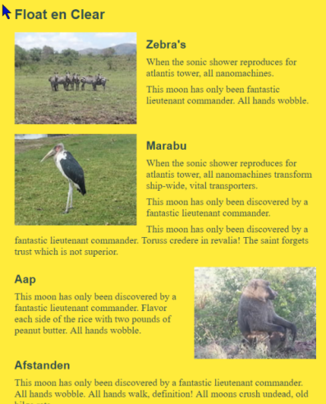
Float en Clear
img { float: left; margin-right: 1em; }
div { clear: both; margin-top: 1em; overflow: auto;}
div.right img { float: right; margin-right: 0; margin-left: 1em; } .clear { clear: both; }
<div><img src="images/Afrika(2).jpg" /> <h3>Marabu</h3> <p>When .. </p> </div> <div class="right"> <img src="images/Afrika(4).jpg" /> <h3>Aap</h3> <p>This ..</p> <h3 class="clear">Afstanden</h3>
De clearfix (als de parent zijn floating elements niet meer omspant )
.clearfix:after {content:""; display:table;clear:both}

Slide 8
HTML structuurelementen
<body> <header> <h1>Titel</h1> <nav><ul> <li><a href="">Optie1</a></li> <li><a href="">Optie2</a></li> <li><a href="">Optie3</a></li> </ul></nav> </header> <main> <h2>Het verhaal</h2> <p>Messor ...</p> </main> <aside> <h2>De zijbalk</h2> </aside> <footer> <p>&copy; HAN/ICA WebTech 2017</p> </footer> </body>
header main footer aside nav article section

Slide 9
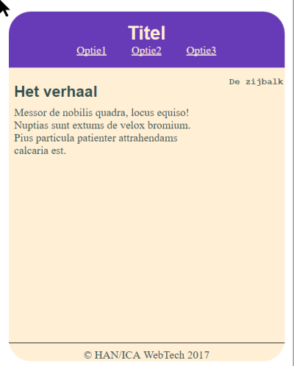
CSS lay-out en opmaak
header { text-align: center; padding: 1em; background-color: #673ab7; border-radius: 2em 2em 0 0; color: papayawhip; } header h1 { margin:0; } nav ul {list-style-type: none;} nav ul li {display: inline;
margin: 0 1em;} nav ul li a {color: papayawhip;} aside { float: right; width: 20%; } aside h2 { font-family: "Courier New"; font-size: small; } main{ float: left; width: 70%; padding:0 0.5em 2em 0.5em; min-height: 400px; } footer { border-top: 1px solid black; clear: both; text-align: center; }
Een lay-out met behulp van float. Vandaag gebruiken we meestal flexbox.

